Slide 1
Switching

Slide 2
Introduction
In large networks we need some means to allow one-to-one communication between any two nodes.
In LANs this is achieved using one of three methods:
  Direct point-to-point connection (mesh)
  Via central controller (star)
  Connection to common bus in a multipoint configuration (bus/hup)

Slide 3

Switched network
Consists of a series of interlinked nodes called switches.
Switches are capable to create temporary connections between two or more devices

Slide 4

Taxonomy of switched networks

Slide 5
CIRCUIT-SWITCHED NETWORKS
A circuit-switched network consists of a set of switches connected by physical links.
A connection between two stations is a dedicated path made of one or more links.
Each connection uses only one dedicated channel on each link.
Each link is normally divided into n channels by using FDM or TDM.

Slide 6

A trivial circuit-switched network

Slide 7
Circuit Switched Network
Switching take place at physical layer
Resources
  Such as bandwidth in FDM and time slot in TDM
  Switch buffer
  Switch processing time
  Switch I/O ports
Data transferred are not packetized, continuous flow
No addressing involved during data transfer

Slide 8

Example

Slide 9
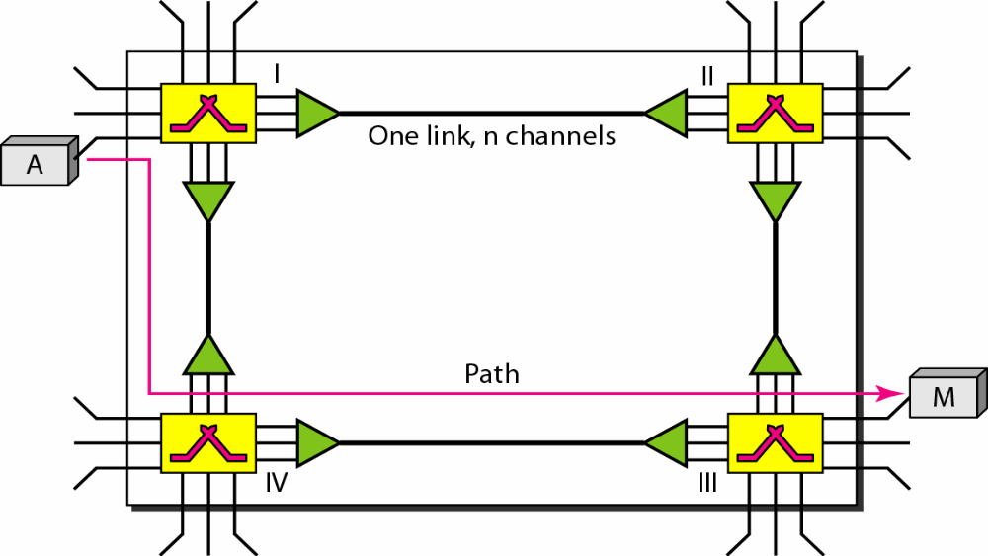
Transmission phases
Setup phase
  A dedicated circuit needs to be established
  So create dedicated channel by sending a request

Slide 10
Transmission phases
Data transfer phase
Teardown phase
  Signal is sent to each switch to release resources
Data Communication

Slide 11

Delay in a circuit-switched network

Slide 12

Note
Switching at the physical layer in the traditional telephone network uses
the circuit-switching approach.

Slide 13
8-2 DATAGRAM NETWORKS
In data communications, we need to send messages from one end system to another. If the message is going to pass through a packet-switched network, it needs to be divided into packets of fixed or variable size. The size of the packet is determined by the network and the governing protocol.
Topics discussed in this section:
Routing Table
Efficiency
Delay
Datagram Networks in the Internet

Slide 14
Datagram Networks
Data are transmitted in discrete units called packets
Size of the packet depends on the protocol and network
Packets switched networks are connectionless, hence no resource allocation
Connectionless means the switch does not keep information about the connection state.
Datagram switching is done at network layer

Slide 15

A datagram network with four switches (routers)
A switch in a datagram network uses a routing table that is based on the destination address
The destination address in the header of a packet in a datagram network remains the same during the entire journey of the packet.

Slide 16

Routing table in a datagram network
A switch in a datagram network uses a routing table that is based on the destination address.
The destination address in the header of a packet in a datagram network remains the same during the entire journey of the packet.

Slide 17

Delay in a datagram network
Switching in the Internet is done by using the datagram approach
to packet switching at the network layer.
Total Delay = 3T + 3t+ w1+ w2

Slide 18
Note
Switching in the internet is done by using the datagram approach to packet switching at the network layer.

Slide 19
VIRTUAL-CIRCUIT NETWORKS
A virtual-circuit network is a cross between a circuit-switched network and a datagram network.
It has some characteristics of both.

Slide 20
Virtual-Circuit Network
Packets form a single message travel along the same path.
Characteristics
  Three phases to transfer data
  Resources can be allocated during setup phase
  Data are packetized and each packet carries an address in the header
  All packets follow the same path
  Implemented in data link layer
Data Communication

Slide 21

Virtual-circuit network

Slide 22

Addressing
Global addressing
  Source and destination needs unique addresses
Virtual-circuit identifier
In virtual-circuit switching, all packets belonging to the same source and destination travel the same path.
But the packets may arrive at the destination with different delays if resource allocation is on demand.

Slide 23

Switch and tables in a virtual-circuit network

Slide 24

Setup request in a virtual-circuit network

Slide 25

Setup acknowledgment in a virtual-circuit network

Slide 26

Source-to-destination data transfer in a virtual-circuit network
After sending all frames, a special frame is send to end the connection

Slide 27

Delay in a virtual-circuit network

Slide 28
Efficiency
In virtual-circuit switching, all packets
belonging to the same source and
destination travel the same path;
But the packets may arrive at the destination with different delays if resource allocation is on demand.
Data Communication

